Slide 1
LAWS AND REGULATION IN PHYSIOTHERAPY
Dr. Vaibhav Kapare
Dept. Of Cardiovascular & Respiratory Physiotherapy
MGM Institute Of Physiotherapy
Chh. Sambhajinagar

Slide 2
Contents;
Laws
Acts
Regulations
Laws and regulation in Physiotherapy
The physiotherapy central council bill, 2017
The National Commission for Allied and Healthcare Professions Bill 2020

Slide 3
WHAT IS A LAW?
Law : A law is a system of regulations that are made to govern people, to help them in their conduct according to the norms of the society.
Law is a generic term that refers to all rules and regulations passed by the parliament and are meant to guide the conduct of people.
Laws are generally : to guide for the protection of people and to maintain public order.
Eg; The Constitution of India is the supreme law of India, LAW commission of INDIA etc.
What is ACT?
Acts are a type of Laws that pertain to specific situations and circumstances. They are passed by the government, to let people know the rules and regulations about specific situations.

Slide 4
Eg. MAHARASHTRA STATE COUNCIL FOR OCCUPATIONAL THERAPY AND PHYSIOTHERAPY ACT, 2004
What is Regulations?
Regulation is a rule or directive made and maintained by an authority - "planning regulations“ according to the law.

Slide 5
LAWS AND REGULATION IN PHYSIOTHERAPY
The Physiotherapists have no such independent legal existence except being practitioners.
There is no single legislation/law covering all aspects of Physiotherapy practice.
Ministry of Health and Family Welfare, Government of India
Allied Health Section 2015-16 - Model Curriculum Handbook PHYSIOTHERAPY
https://main.mohfw.gov.in
LAWS AND REGULATION IN PHYSIOTHERAPY can be discuss in following points:
  Laws Governing the Qualifications / Practice and Conduct of Professionals
  Law Related to Governing the Commissioning of Hospital
  Law Governing The Safety of Patients, Public and Staff within the Hospital Premises and Environmental Protection.
  Laws Governing Medico Legal Aspects
  Laws Governing the Employment of Manpower.
  Regulations Governing the Business Aspects of Hospital.

Slide 6
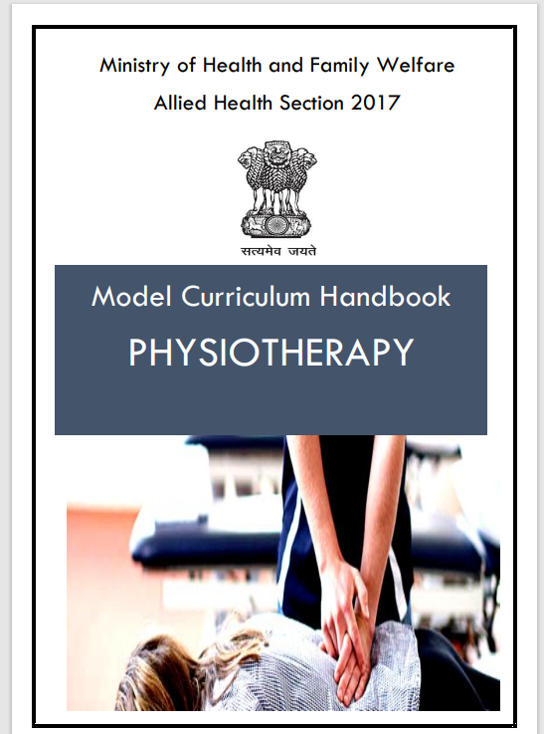

Slide 7
Laws Governing the Qualifications / Practice and Conduct of Professionals
DELHI COUNCIL FOR PHYSIOTHERAPY & OCCUPATIONAL THERAPY constituted under section 3 of Act No. 7 of 1997 Govt. of NCT Delhi.
MAHARASHTRA STATE COUNCIL FOR OCCUPATIONAL THERAPY AND PHYSIOTHERAPY ACT, 2004
GUJARAT STATE COUNCIL FOR PHYSIOTHERAPY -2011
RAJASTHANA PARAMEDICAL COUNCIL 2015
MADHYA PRADESH PARAMEDICAL COUNCIL-2003
THE HIMACHAL PRADESH PARAMEDICAL COUNCIL ACT, 2003
In Karnataka State, the Physiotherapy Association forms “KARNATAKA STATE PHYSIOTHERAPY FEDERATION” 2015
THE PHYSIOTHERAPY CENTRAL COUNCIL BILL, 2017
(Bill for the Establishment of Central Physiotherapy Council of India is under process in Rajaya Sabha that remains status quo.)

Slide 8
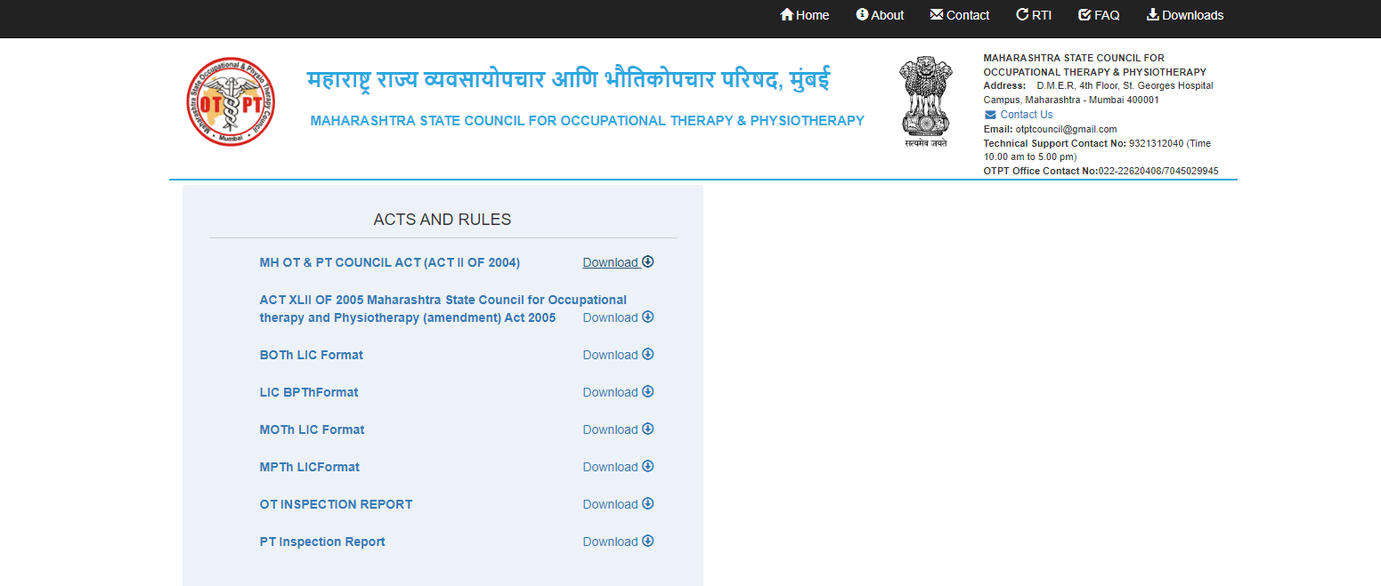

Slide 9
Law Related to Governing the Commissioning of Hospital
Society registration Act 1960
Companies Act 1956
Urban land Act 1976
National building code 2005
Building permit from municipality
Government Buildings Act, 1899
Maharashtra Medical Council Registration (Amendment) Act, 2003
Bombay Nursing Homes Registration Act,1949
Red Cross Society (Allocation of Property) Act, 1936
St. John Ambulance Association (India) Transfer of Funds Act, 1956
The Clinical Establishments (Registration and Regulation) Act, 2010 ("Act") has been enacted by the Central Government to provide for registration and regulation of all clinical establishments in the country with a view to prescribing the minimum standards of facilities and services provided by them.
NATIONAL ACCREDITATION BOARD FOR HOSPITALS & HEALTHCARE PROVIDERS (NABH) ; A Constituent Board of Quality Council of India

Slide 10
Law governing the safety of patients, public and staff within the hospital premises
No objection certificate from the chief fire officer.
Periodic fitness certification for operation of lifts.
Rules for provision of safe drinking water
The cigarettes and other Tobacco products (prohibition of advertisement and Regulation of trade and commerce , production , supply and distribution ) bill 2003
Prohibition of smoking in public places Rules 2008.
Rules for provision of safe drinking water.
Protection of Human Rights Act, 1993

Slide 11
Laws Governing Medico Legal Aspects
Law of privileged communications
Indian Evidence act ( disclosure of privileged / confidential patient related information before a court of law – under protest )
Law of torts
A tort means ‘wrong’. It is a violation of the general duty which every member of the society is obliged so as not to do any harm without lawful justification or excuse.
If by the act of an individual, an injury is caused to a third person, the affected person is entitled to claim compensation from the doer. Under the Torts, only the petitioner has to prove the case against the respondent.

Slide 12
Consumer protection Act 1986
Consumer Protection Act, 1986 is an Act of the Parliament of India enacted in 1986 to protect the interests of consumers in India.
Protection of human rights Act
Liability for professional negligence-
  Tort
  standard of care,
  problems of evidence,
  contractual liability,
  criminal liability,
  Liability of doctors and hospitals under Consumer Protection Act.

Slide 13
Laws Governing the Employment of Manpower
TDS Act (Tax Deduction at Source)
Child labour Act
Citizenship Act 1955
Maternity Benefit (Amendment) Act, 2008
Workmen’s Compensation Act, 1923
Workmen's Compensation (Amendment) Act, 2009
Employees provident fund and misc provision Act 1952
ESI Act 1948
ESI ( central ) Rules 1950
Employment exchange ( compulsory notification of vacancies ) act 1959
Equal remuneration Act 1976
Minimum Wedge Act 1948
Payment of bonus Act 1965
Payment of Gratuity Act 1972
Payment of wages Act, 1963
PPF Act 1968

Slide 14
Regulations Governing the Business Aspects of Hospital
Income Tax ACT 1961
(Personal Tax, professional Tax, Company Tax, TDS)- Quarterly, Annually
Registration under States Sales Tax Act, and Central and State Excise Act ( i. Sales Tax Department ii. Central and State Excise Depts.)
From July 1, 2010, services provided by hospitals, nursing home or multi-specialty clinics to employees of business entities are taxable under the category “Health Services”.
Service tax refers to tax collected by the government of India from certain service providers for providing certain services.
The person who pays service tax can be either a service provider or a service receiver or any other person who is responsible for providing certain services.
INSURANCE
The Public Liability Insurance Act, 1991, amended 1992
The Public Liability Insurance Rules, 1991, amended 1993 Various licenses / certificate required with sanctioning authority
Professional Indemnity Insurance

Slide 15
THE PHYSIOTHERAPY CENTRAL COUNCIL BILL, 2017
A BILL to provide for the constitution of Central Council of the Physiotherapy, the co-ordinated development in the education of physiotherapy with a view to regulating and maintaining standards of such education, maintenance of Register of Physiotherapists. (Bill for the Establishment of Central Physiotherapy Council of India is under process in Rajaya Sabha that remains status quo.)
The main object of the Central Council are as under :-
To prescribe minimum standards of education in Indian Systems of Physiotherapy.
To recommend Central Government in matters relating to recognition (inclusion/withdrawal) of Physiotherapy qualifications
To maintain a Central Register of Indian Physiotherapy and revise the Register from time to time.
To prescribe Standards of Professional Conduct, Etiquette and Code of Ethics to be observed by the practitioners.
To consider and furnish the recommendation to Government of India on proposal received from various institutes from Government of India for establishment of new colleges of Indian Systems of Physiotherapy, to increase intake capacity in Under-graduate, Post-graduate and to start new or Post-graduate additional subjects.

Slide 16
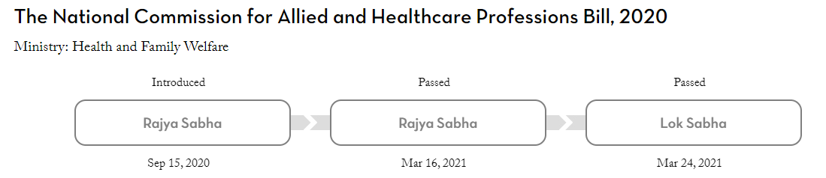
The National Commission for Allied and Healthcare Professions Bill

Slide 17
The National Commission for Allied and Healthcare Professions Bill, 2020 was introduced in Rajya Sabha by the Minister of Health and Family Welfare, Dr. Harsh Vardhan, on September 15, 2020.
The Bill seeks to regulate and standardise the education and practice of allied and healthcare professionals.
Key features of the Bill include:
Allied health professional: The Bill defines ‘allied health professional’ as an associate, technician, or technologist trained to support the diagnosis and treatment of any illness, disease, injury, or impairment. Such a professional should have obtained a diploma or degree under this Bill. The duration of the degree /diploma should be at least 2,000 hours (over a period of two to four years).
Healthcare professional: A ‘healthcare professional’ includes a scientist, therapist, or any other professional who studies, advises, researches, supervises, or provides preventive, curative, rehabilitative, therapeutic, or promotional health services. Such a professional should have obtained a degree under this Bill. The duration of the degree should be at least 3,600 hours (over a period of three to six years).

Slide 18
Allied and healthcare professions: The Bill specifies certain categories of allied and healthcare professions as recognised categories. These are mentioned in the Schedule to the Bill and include life science professionals, trauma and burn care professionals, surgical and anaesthesia related technology professionals, physiotherapists, and nutrition science professionals.
National Commission for Allied and Healthcare Professions: The Bill sets up the National Commission for Allied and Healthcare Professions. The Commission will consist of: (i) the Chairperson, (ii) Vice-Chairperson, (iii) five members (at the level of Joint Secretary), (iv) one representative from the Directorate General of Health Services, (v) three Deputy Directors or Medical Superintendents appointed on a rotational basis from amongst medical institutions including the AIIMS, Delhi and AIIPMR, Mumbai, and (vi) 12 part-time members representing State Councils.

Slide 19
Functions of the Commission: The Commission will perform the following functions with regard to Allied and Healthcare professionals: (i) framing policies and standards for regulating education and practice, (ii) creating and maintaining an online Central Register of all registered professionals, (iii) providing basic standards of education, courses, curriculum, staff qualifications, examination, training, maximum fee payable for various categories, and (iv) providing for a uniform entrance and exit examination, among others.
Professional Councils: The Commission will constitute a Professional Council for every recognised category of allied and healthcare professions. The Professional Council will consist of a president and four to 24 members, representing each profession in the recognised category.
State Councils: Within six months from the passage of the Bill, state governments will constitute State Allied and Healthcare Councils.

Slide 20
Offences and penalties: No person is allowed to practice as a qualified allied and healthcare practitioner other than those enrolled in a State Register or the National Register. Any person who contravenes this provision will be punished with a fine of Rs 50,000.

Slide 21
Thank You

